Slide 1
Memory Organization
Input –Output Organization

Slide 2
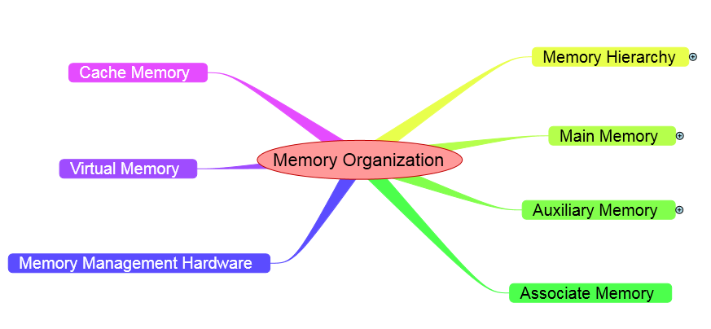

Slide 3
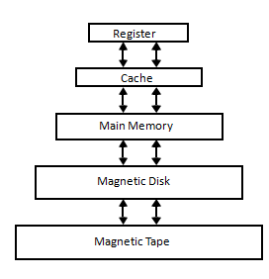
Memory Hierarchy
The hierarchical arrangement of storage in current computer architectures is called the memory hierarchy.

Slide 4
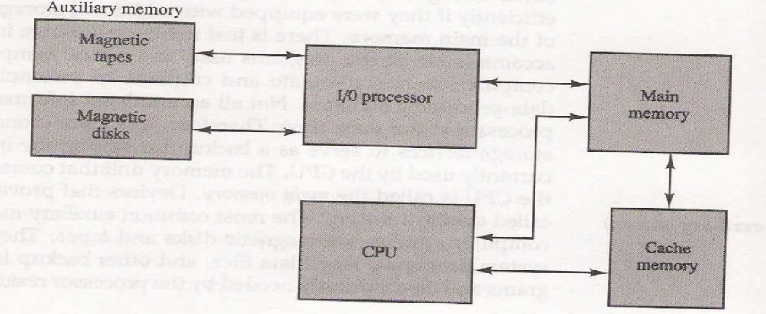
Memory Hierarchy
Main Memory : memory unit that communicates directly with the CPU (RAM)
Auxiliary Memory : device that provide backup storage (Disk Drives)
Cache Memory : special very-high-speed memory to increase the processing speed (Cache RAM)

Slide 5
Main Memory
Main memory is central storage unit in computer system
  RAM and ROM Chips
  Bootstrap Loader
    A program whose function is to start the computer software operating when power is turned on.
    Loads a portion of the operating system from disk to main memory and control is then transferred to the operating system, which prepares the computer for general use.

Slide 6
Typical RAM chip
RAM chip is better suited with communication with CPU
Control inputs select when need
Bidirectional data bus
A bidirectional bus can be constructed with three state buffers.
Possible states: a signal equivalent to logic 1, a signal equivalent to logic 0, or a high impedance state.

Slide 7
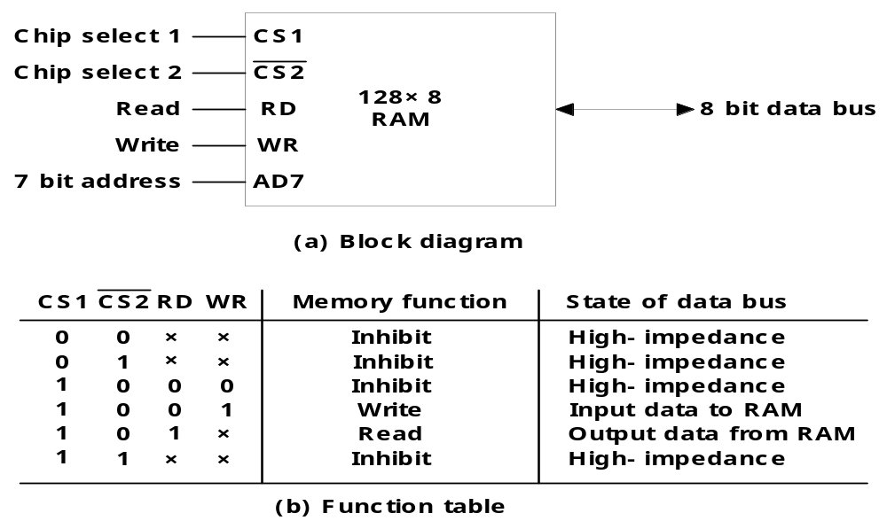
Typical RAM chip
The logic 1 and 0 are normal digital signals.
The high impedance state behaves like an open circuit, which means that the output does not carry a signal and has no logic significance.

Slide 8
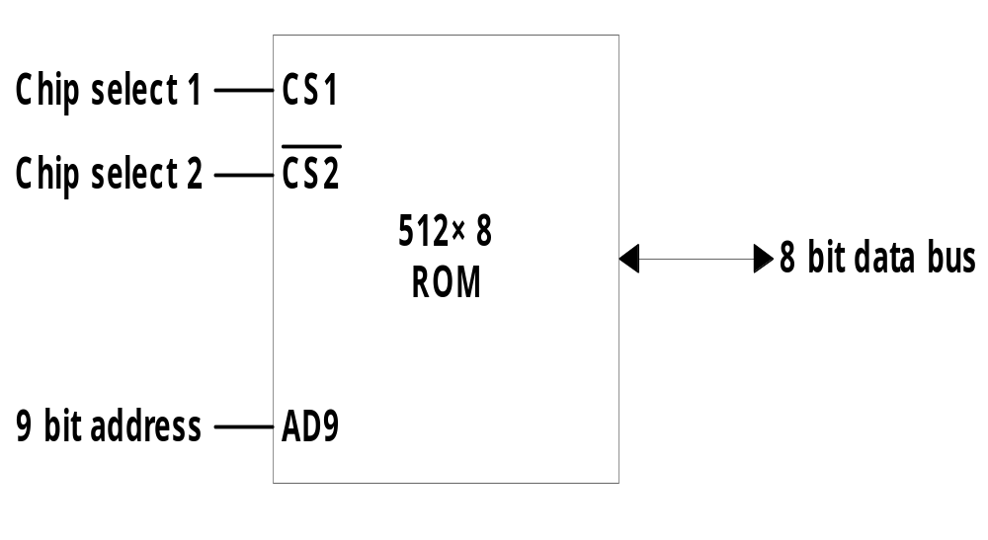
Typical ROM chip
A ROM chip is organized externally in a similar manner, however, since a ROM can only read, the data bus can only be in an output mode
The two chip select inputs must be CS1=1 and CS2=0 for the unit to operate. Otherwise, the data bus is in a high impedance state.

Slide 9
Auxiliary Memory
The most common auxiliary memory devices used in computer systems are Magnetic Disks And Tapes.
Important characteristics of any device
  Access mode
  Access time
  Transfer rate
  Capacity
  Cost
The average time required to reach a storage location in memory and obtain its contents is called the access time.
The access time = seek time + transfer time
Seek time: required to position the read-write head to a location
Transfer time : required to transfer data to or from the device

Slide 10
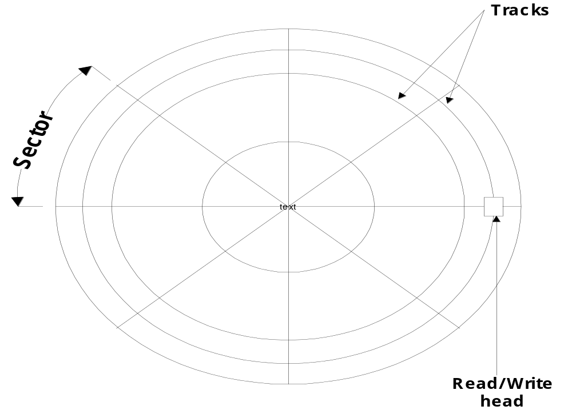
Magnetic disk

Slide 11
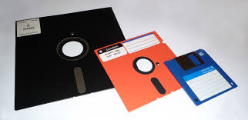
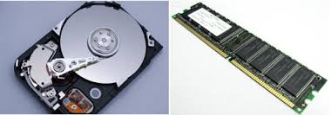
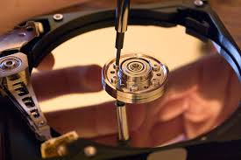
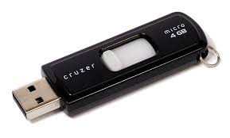

Slide 12
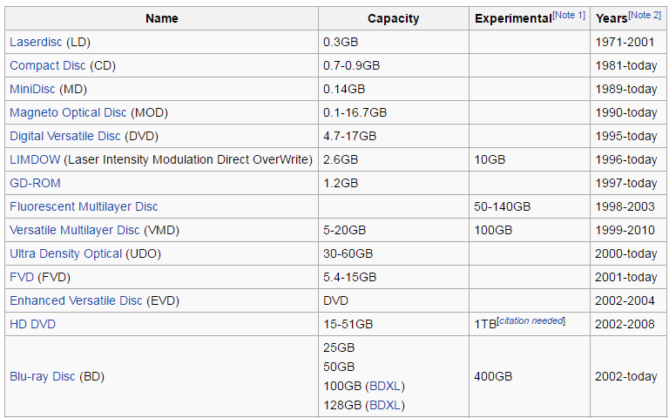

Slide 13
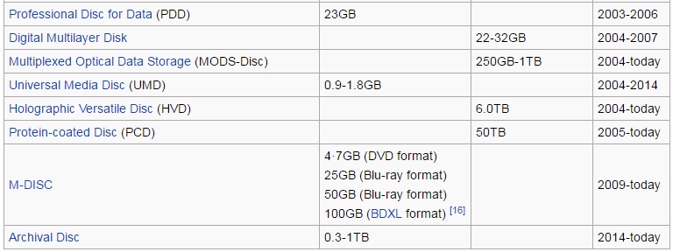

Slide 14
Associate Memory
The time required to find an item stored in memory can be reduced considerably if stored data can be identified for access by the content of the data itself rather than by an address.
A memory unit accessed by content is called an associative memory or content address memory (CAM).

Slide 15
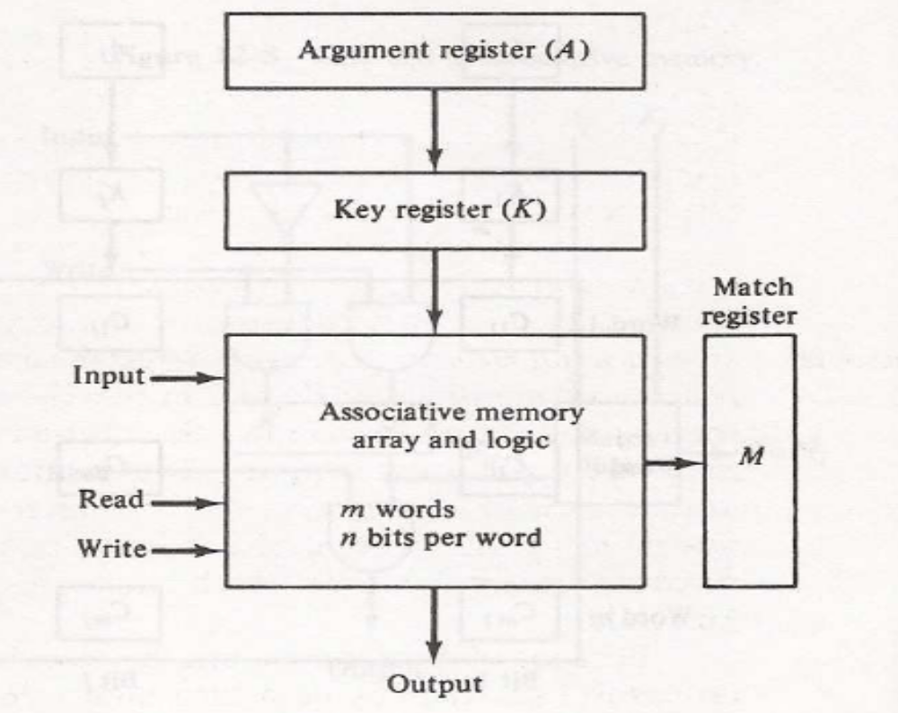
Hardware Organization:
The block diagram of an associative memory is shown in the Figure. It consists of a memory array and logic for m words with n bits per word.
Each word in memory is compared in parallel with the content of the argument register.
The words that match the bits of the argument register set a corresponding bit in the match register

Slide 16
Cache Memory

Slide 17
Cache Memory
Cache Memory : a fast small memory
  keeping the most frequently accessed instructions and data in the fast cache memory
  cache size : 256 K byte || 512 K byte
  mapping method :
  replace algorithm : 1) LRU, 2) LFU, 3) FIFO
  write policy : 1) write-through, 2) write-back

Slide 18
Cache Memory
Hit Ratio
  the ratio of the number of hits divided by the total CPU references (hits + misses) to memory
    hit : the CPU finds the word in the cache
    miss : the word is not found in cache (CPU must read main memory)
  cache memory access time = 100 ns
  main memory access time = 1000 ns
  hit ratio = 0.9

Slide 19
  Mapping
The transformation of data from main memory to cache memory is refers as mapping process
  1) Associative mapping
  2) Direct mapping
  3) Set-associative mapping

Slide 20
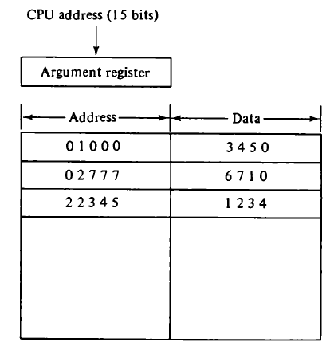
Associative Mapping
In Associative memory both address and content (data) of memory word
Address value is 15 bits ie five- digit octal number
12 bit word ie four – digit octal number
Procedure to replace the cells of the cache is Round- robin
FCFS replacement Policy
The fastest and most flexible cache organization uses an associative memory.
The associative memory stores both the address and data of the memory word.
This permits any location in cache to store ant word from main memory.

Slide 21
Direct Mapping
If the CPU Address is of 15 bits its divided into two fields
First nine least significant bits index fields
Remaining six bits are tag fields

Slide 22
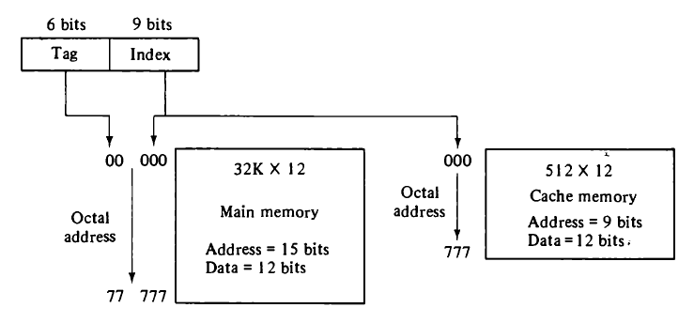
Direct Mapping

Slide 23
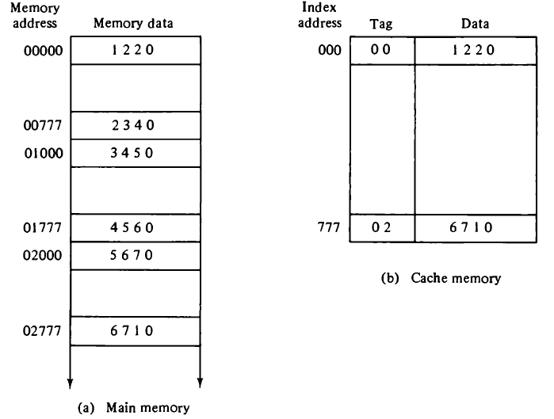

Slide 24
Set Associate Mapping
Disadvantage in direct mapping if two words with same index but different tags value cannot reside in the memory at same time
In this mapping two or more words of the memory can store under the same index

Slide 25
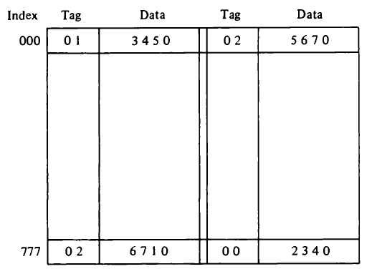
Set Associate Mapping

Slide 26
Virtual Memory
The programs are stored first in auxiliary memory
When CPU need it is brought from the main memory
Virtual memory is the concepts where user construct programs has large memory space is available.
CPU go to address mapping so called Virtual address to physical address in main memory
The address used by a programmer will be called a virtual address or logical address.
An address in main memory is called a physical address

Slide 27
Virtual address gives programmer the illusion that they have very large memory space
Virtual memory is mechanism program generated – address to correct main memory location.
This translation can be done by mapping table

Slide 28
Address space and Memory Space
Address used by the programmer will be called virtual address
Set of such address are called address space
Set of such locations is called memory space

Slide 29
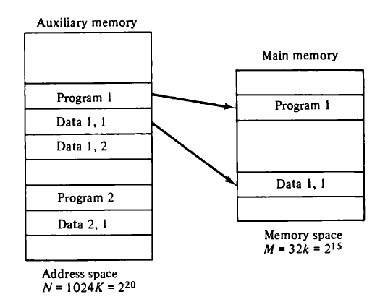

Slide 30
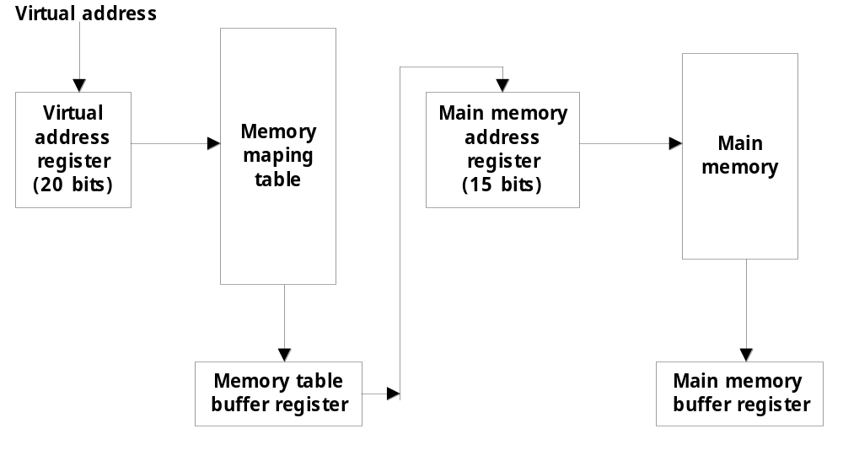
Example : virtual address is 20 bits to physical address is 15 bits .

Slide 31
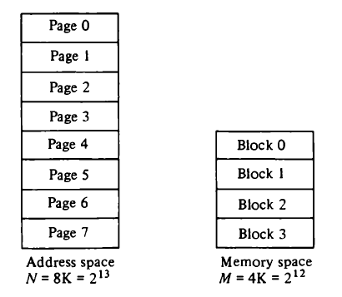
Address Mapping Using Pages

Slide 32
Address Mapping Using Pages
Physical memory is broken into groups called blocks
1K block its consists of 1024 pages
Example :
  Memory page table consists of eight words, one for each page.
  CPU consist 13 bit virtual address
  Higher –order 3 bits virtual address specify page number
  Line numbers from virtual address is transferred into 10 low-order bits of memory address register

Slide 33
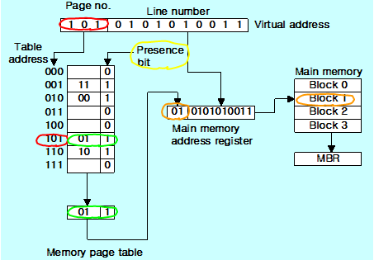

Slide 34
Input-output Organization

Slide 35
Input / Output Problems
Wide variety of peripherals
  Delivering different amounts of data
  At different speeds
  In different formats
All slower than CPU and RAM
Need I/O modules

Slide 36
Input/Output Module
Interface to CPU and Memory
Interface to one or more peripherals

Slide 37
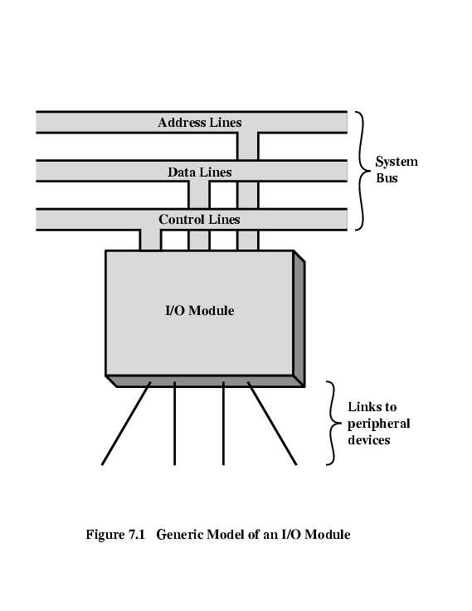
Generic Model of I/O Module

Slide 38
External Devices
Human readable
  Screen, printer, keyboard
Machine readable
  Monitoring and control
Communication
  Modem
  Network Interface Card (NIC)

Slide 39
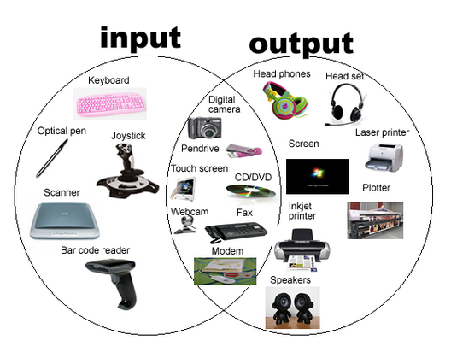


Slide 40
Magnetic Tape:
These are commonly used for storing files of data.
Access is sequential and consists of records that can be accessed one after the other as the tape moves along a stationary read-write mechanism.
Advantages:
Very cheap.
The tapes can be removed very easily.
Disadvantage
Slow accessing.

Slide 41
Magnetic Disk:
It has high-speed rotational surface area coated with magnetic material.
Access is achieved by moving a read-write mechanism to a track in the magnetized surface.
These are used for storing bulk storage of programs and data.

Slide 42
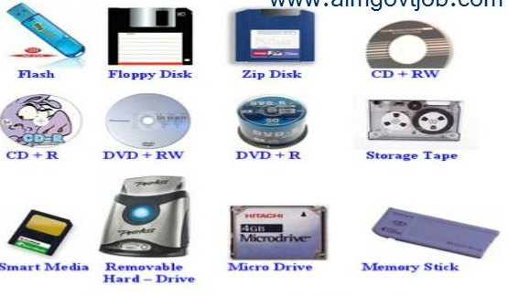

Slide 43
ASCII Alphanumeric characters
I/O devices communicate with people and the computers are usually involved in the transfer of alphanumeric information.
The standard binary code for the alphanumeric characters is ASCII (American Standard Code For Information Interchange).
It uses 7 bits to code the characters.
It contains of 94 printable characters and 34 non- printable(control) characters.
printable characters include 0-9 A-Z a-z and 32 special symbols like #,$,@,^ etc.,

Slide 44
There are 3 types of control characters
Format Effectors: That control the layout of printing
  backspace(BS), horizontal tabulation(HT).
Information Separators: used to separate the data into divisions like paragraphs and pages.
  Record Separator(RS) ,File Separator(FS).
Communication controller: used during the transmission of text between remote terminals.
  Start of Text(STX) , End of Text(ETX).

Slide 45
I/O Module Function
Control & Timing
CPU Communication
Device Communication
Data Buffering
Error Detection

Slide 46
I/O Steps
CPU checks I/O module device status
I/O module returns status
If ready, CPU requests data transfer
I/O module gets data from device
I/O module transfers data to CPU

Slide 47
Input-Output Interface
Input-Output Interface provides a method for transferring information between internal storage and external I/O device.
Peripherals connected to a computer need special communication links for interfacing them with the CPU.
Communication link is to resolve the differences between the central computer and each peripheral.

Slide 48
The major differences are:
Conversion of signals may be required.
      Synchronization mechanism.
Data codes and formats in peripherals differ from the word format in the CPU
The operating modes of peripherals are different from each other
      Peripherals must be controlled
      not to disturb the operation

Slide 49
These components are called “interfaces.
Interface means attach 2 or more components or systems via their respective interface points for data exchanges between them.
  I/O Bus and Interface Modules :
    I/O Bus
      Data lines
      Address lines
      Control lines
    Interface Modules :
      SCSI (Small Computer System Interface)
      IDE (Integrated Device Electronics)
      Centronics
      RS-232

Slide 50
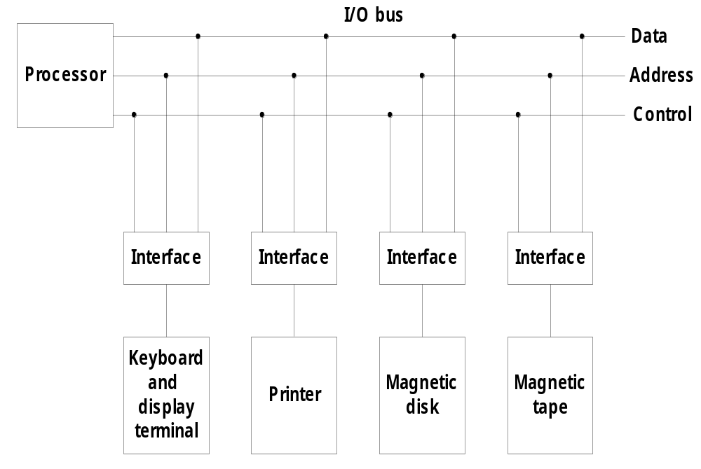
I/O Bus and Interface Modules

Slide 51
The Function code is referred as I/O Command.
Control command: issued to activate the peripheral and to inform it what to do
Status command: used to test various status conditions in the interface and the peripherals.
Output data: transferring data from the bus into one of its registers.
Input data: it is opposite of Output data. The interface receives an item of data from the peripheral and places it in its buffer register.

Slide 52
I/O versus Memory Bus
IO also communicate with memory
The memory also contains the address, data, read/write control lines.
There are 3 ways that computer buses can be used to communicate with the memory & I/O.
  Use 2 separate buses.
  Using common bus for both memory & I/O but have separate control lines for each.
  Using common bus for both memory & I/O with common control lines for each.

Slide 53
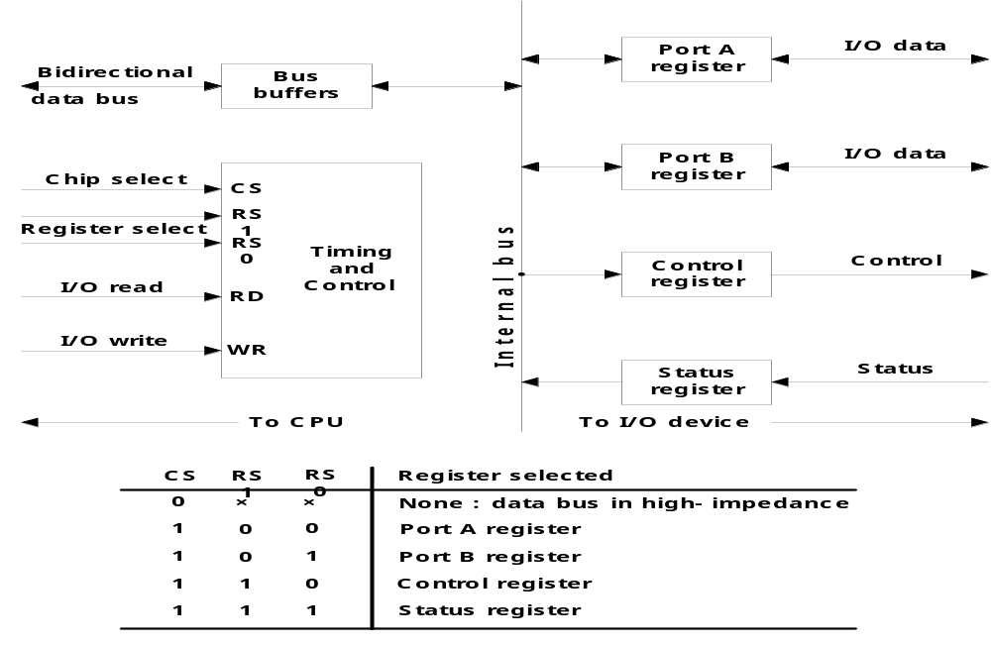
Example of I/O Interface

Slide 54
Modes of Transfer
Data transfer between the central computer and I/O devices may be handled in a variety of modes.
  Programmed I/O
  Interrupt-Initiated I/O

Slide 55
Programmed I/O
CPU has direct control over I/O
  Sensing status
  Read/write commands
  Transferring data
CPU waits for I/O module to complete operation
Wastes CPU time

Slide 56
Programmed I/O - detail
CPU requests I/O operation
I/O module performs operation
I/O module sets status bits
CPU checks status bits periodically
I/O module does not inform CPU directly
I/O module does not interrupt CPU
CPU may wait or come back later

Slide 57
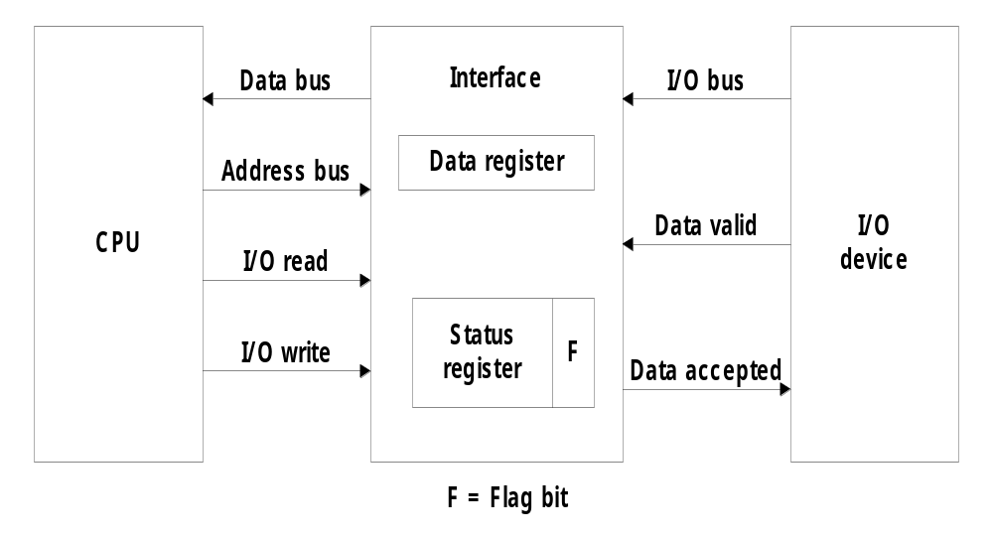
Programmed I/O
Programmed I/O operations are the result of I/O instructions written in the computer program.
Each data item transfer is initiated in the program.

Slide 58
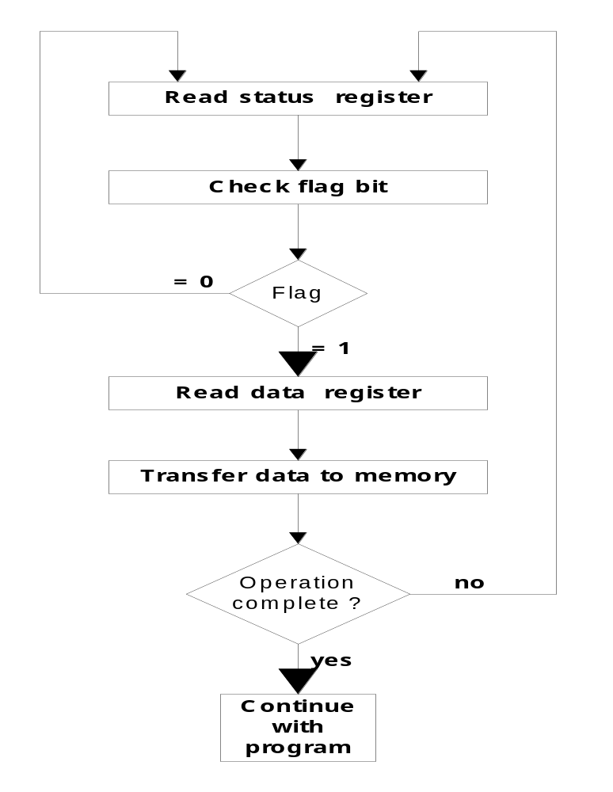

Slide 59
Priority Interrupt
A Priority Interrupt is a system that establishes a priority over the various sources
to determine which condition is to be served first when 2 or more requests arrive simultaneously.
The priorities can be assigned in 3 ways:
  Polling
  Daisy-Chain priority.
    Control lines of devices are connected in series
  Parallel priority.

Slide 60
Direct Memory Access (DMA)
The transfer of data between a fast storage device such as magnetic disk and memory is often limited by the speed of the CPU.
Removing the CPU from the path and letting the peripheral device manage the memory buses directly would improve the speed of transfer.
This transfer technique is called direct memory access (DMA).

Slide 61
Direct Memory Access (DMA)
During DMA transfer, the CPU is idle and has no control of the memory buses. A DMA controller takes over the buses to manage the transfer directly between the I/O device and memory.
The Bus Request (BR) input is used by the DMA controller to request to the CPU to relinquish the control of the bus.
The CPU activates the Bus Grant(BG) o/p to inform the DMA that the buses are in high-impedance state.
The DMA that originated the bus request can now take control of the bus.
Burst Transfer A block sequence consisting of number of memory words is transferred in a continuous burst while the DMA controller is the master of the memory buses.
  This is used in magnetic disks.

Slide 62
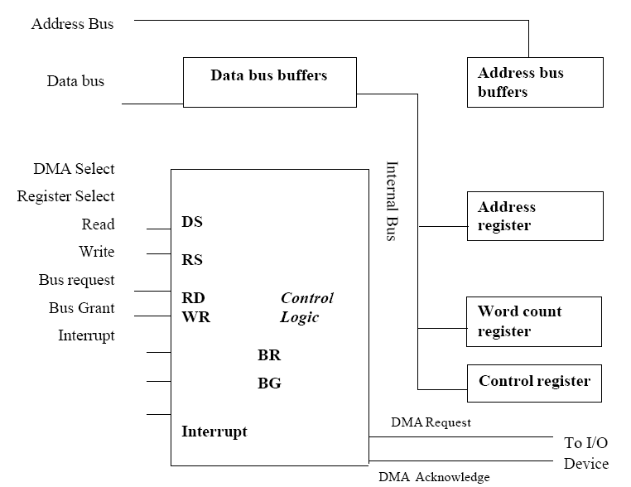

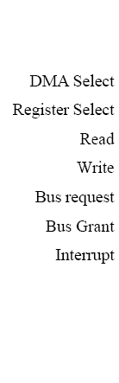


Block Diagram of DMA Controller

Slide 63
Input-Output Processor
Instead of having each interface communicate with the CPU ,a computer may incorporate 1 or more external processors and assign them the task of communication directly with all I/O devices.
An IOP may be classified as a processor with direct memory access capability that communicates with the all I/O devices.
In this configuration, the computer may have a memory unit and a number of processors comprised of CPU and 1 or ore IOP’s.
Each IOP takes care of I/O tasks relieving the CPU for other works.
The IOP is similar to CPU except that it is designed to handle the details of I/O Processing.
The IOP can perform other tasks like arithmetic, logic, branching and code translation.
The instructions that are read from memory by an IOP are sometimes called as commands to distinguish them from instructions that are read by the CPU.

Slide 64
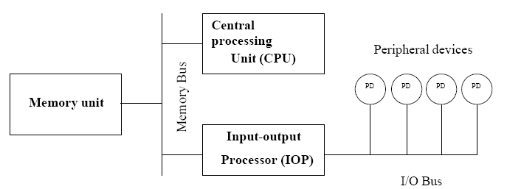
Block diagram of a computer with I/O processor

